Slide 1
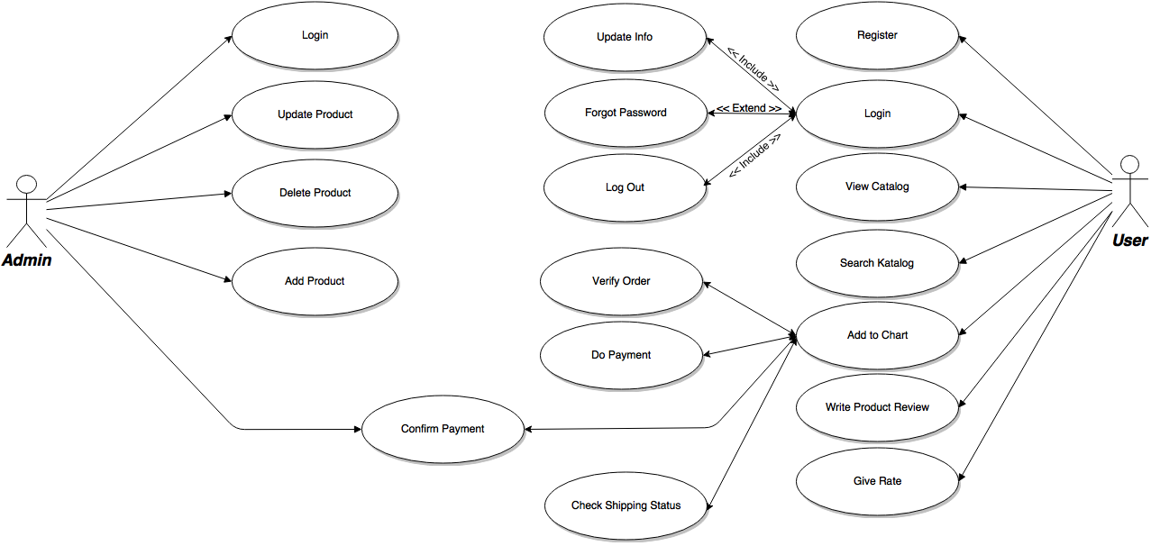

Slide 2
Use Case Description For Admin
Login : Admin can login with email and password, if email and password didn’t match with database, error message will be shown.
Add Product : Admin have authority to add product with detail of that product.
Update Product : Used for edit detail product include Price, Stock, ETC.
Delete Product : If product no longer available for long time or something happen, admin can delete that product.
Confirm Payment : If user buy something and then confirm the payment admin should confirm that payment and then shipping the product.

Slide 3
Use Case Description For User
Register : User Should register the account and add profile detail first before buying the product
Login : If user already registered, user can login with input username and password, system will shown error message if username and password that user input didn’t match with data in the databases.
Update Info : After login User can update they user info on the profile page.
Forgot Password : If user forgot their password when login, they can easily reset their password.
Logout : User can logout their account whenever wherever

Slide 4
Register : User Should register the account and add profile detail first before buying the product
Login : If user already registered, user can login with input username and password, system will shown error message if username and password that user input didn’t match with data in the databases.
View Catalog : User can see the product catalog even if they didn’t login yet.
Search Catalog : User can search in the product catalog even if they didn’t login yet.
Add to Chart : if user click buy the product will be add to chart, only happen if user already login, if user didn’t login yet, login form will be shown.

Slide 5
Verify Order : After user add product to chart they shoul verify it to procced to do payment
Do Payment : User will do payment in this step
Confirm Payment : After user do payment they need to confirm and verifying their payment.
Check Shipping Status : User can track their product.
Write Review : After the product user ordered arrived, they can write the review about that product.
Give Rate : Rate can given to show how much user satisfying level to the product they ordered.

